Slide 1
Internet marketing

Slide 2
Get the slides and other material
www.ilkkakauppinen.com/mojaafrica

Slide 3
Program
Basics of the marketing
Basics of the internet marketing
Building a trust
Pricing
SEO a.k.a. Search Engine Optimatisation
Social media
Email marketing
Internet selling
Traditional marketing
Selling to travel agencies, work shops

Slide 4
Today
Introductions
Target groups
Goals
Differentiation
Products
Home work

Slide 5
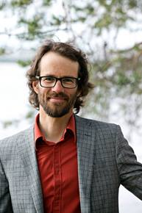
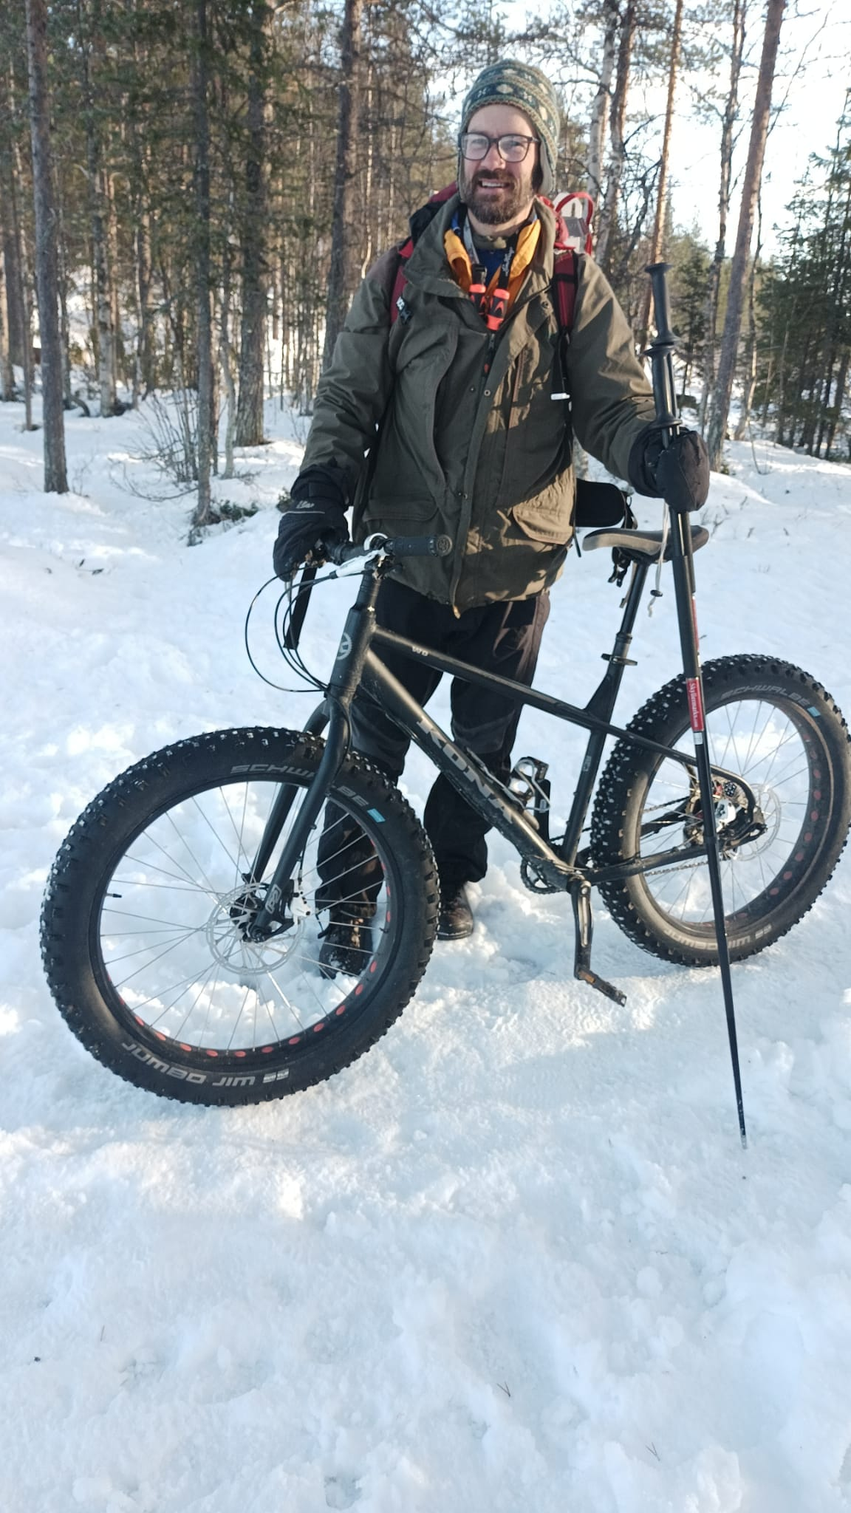
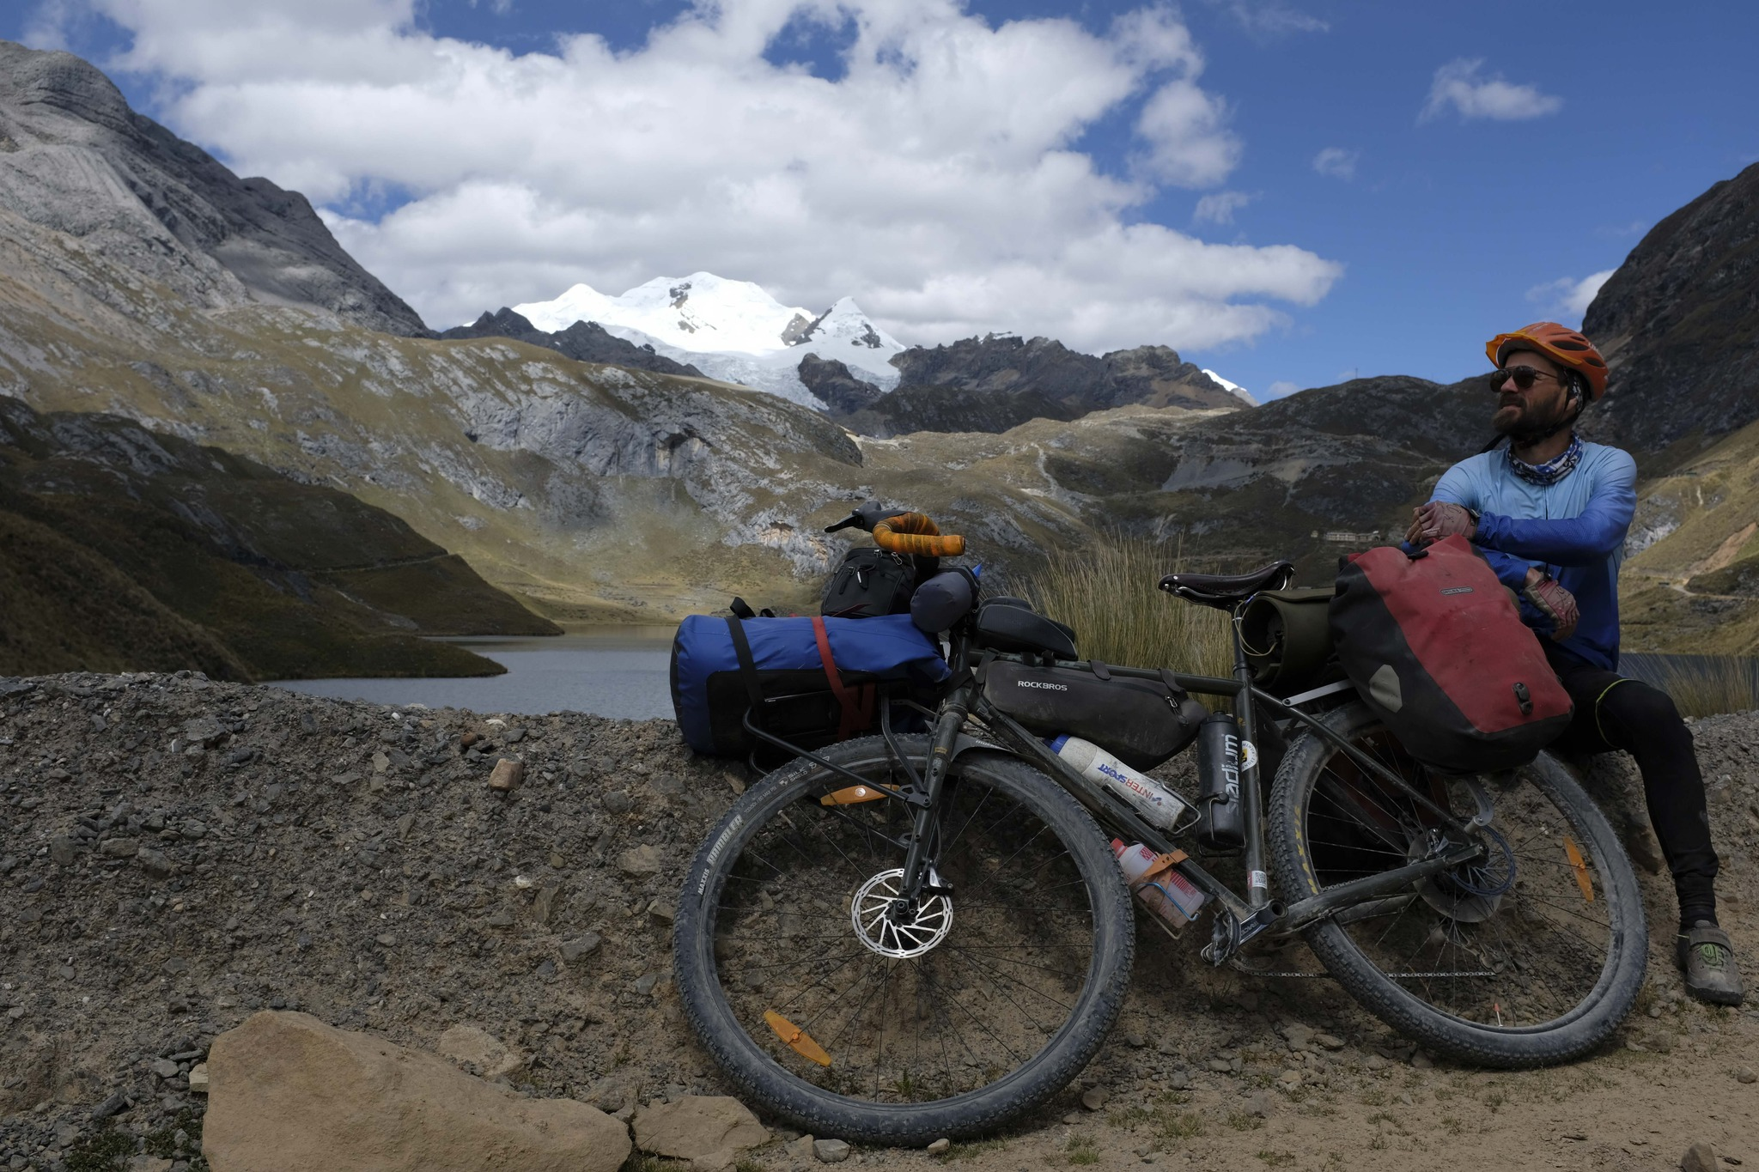
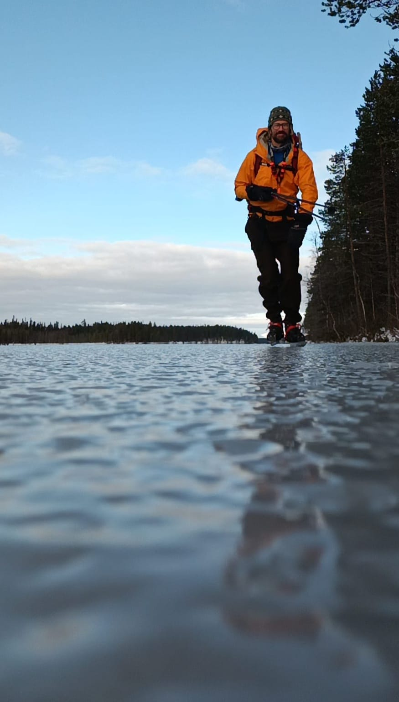
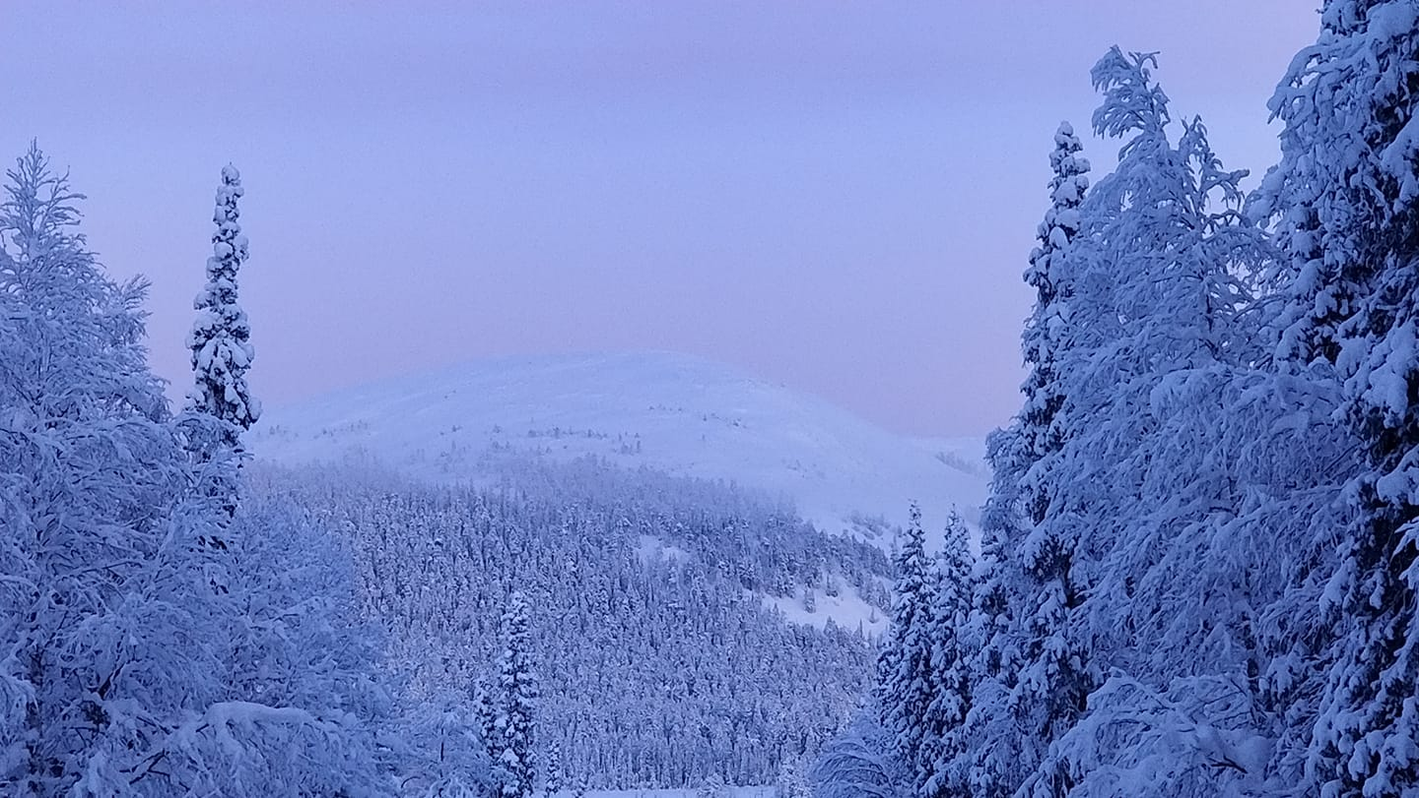
www.linkedin.com/in/ilkkakauppinen

Slide 6
YOU?

Slide 7
A
D
I
A
Elias St. Elmo Lewis, (1911)

Slide 8
2 things matter
Right customers find you
Customers trust you = they buy

Slide 9
Question?
When are your high and low season?
Climbing December to March high, June to November high
Safaris All the year

Slide 10
Target Group
Why: ones in a lifetime, to challenge their body, seven peak challengers. A safe adventure? Culture.
Basic family with children from 5yrs, Adults up 70s yrs. if they have a little physical to walk shortdistance, and not dependent for everything.
Age for us is just a number, all of our tours are designed for everyone, different ages and numberof clients doesn’t matter we can deal with all, starting Individual client, small group up to large group.

Slide 11
Target Group
Most important?
Returning customers – recommendations!
Which can be increased? – group of students, internships programs: Finnish, Sweden, reason is African.

Slide 12
Your goals?
To have more students groups
Family groups
Older retired people
To expand company also to accommodation
To increase pricing

Slide 14
Products
School internships and other clients
Mountains hiking
Adventure safari
Beach holiday
Additional
Luxury safari
Photographer safaris
Companies group safaris
Wildlife researchers’ trip
Kilimanjaro climbing experience
Local trip such coffee tour, walk into villages and waterfalls deep Africa
Culture learning experiences
Language exchange programs
Volunteers placement and accommodations
Beach holidays trips: including famous Zanzibar

Slide 15
Differentation
What is your core competence?
You show them reality
Service

Slide 16
Pricing?
Price is a key component in trust
Part of target group. Are they price sensitive? Customer compare prices and are price sensitive
Do not sell too low
Does not have to be same for all the customers and selling channels
Depends on the competitors
Differentiation and marketing are core components
Additional selling and upselling
Need help with this?

Slide 17
Selling channels
80% social media
20% recommendations
How they book? DM in social media or email

Slide 18
Next meeting?
Next Thursday same time 10-12 Finnish. Ilkka will send the meeting link on Wednesday.

Slide 19
Homework
Website, please send Ilkka screen shots
Google Analytics, instal and more info https://marketingplatform.google.com/about/analytics/ Please notice that it’s a very complex program, but in the beginning we just need the basic functions. If you are unable to install it it, please contact me. It is a free program.

